Slide 1
MODULE-4

Slide 2
SCR
An SCR is a three-terminal, three-junction, and four-layer semiconductor device that is used to perform switching functions in power circuits.
Sometimes the SCR is also called as Thyristor.

Slide 3
Constructional Details of SCR
The SCR has three pn – junctions, and four layer of p and n type semiconductor joined alternatively to get pnpn device.
The three terminals are taken –
one from outer p – type layer called anode (A),
second from the outer n – type layer called cathode (K) and
the third from the internal p –type layer called gate (G).

Slide 4
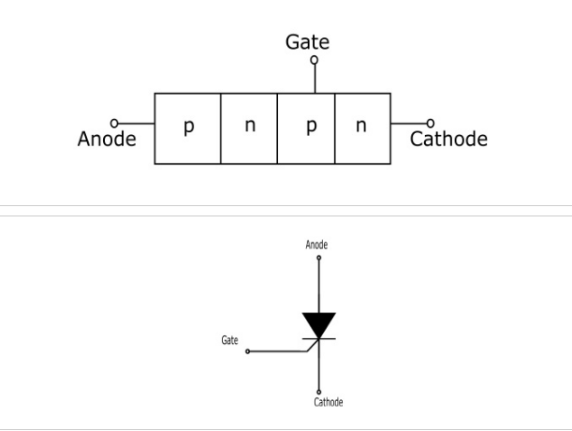

Slide 5
Working of SCR
In a SCR, the load is connected in series with the anode. The anode is always kept positive with respect to cathode.
When Gate is Open Circuited
When no voltage applied to gate terminal, junction J2, is reverse biased and the junctions J1 and J3 are forward biased. Since one of the three junctions is reverse biased so there is no current can flow through the load, hence the SCR is OFF.
However if the applied voltage is gradually increased, a stage is reached, when reverse biased junction (J2) breaks down. The SCR now, starts conducting and become ON. The value of applied voltage at which the reverse biased junction breaks down and the SCR becomes ON is known as Breakover Voltage.

Slide 6
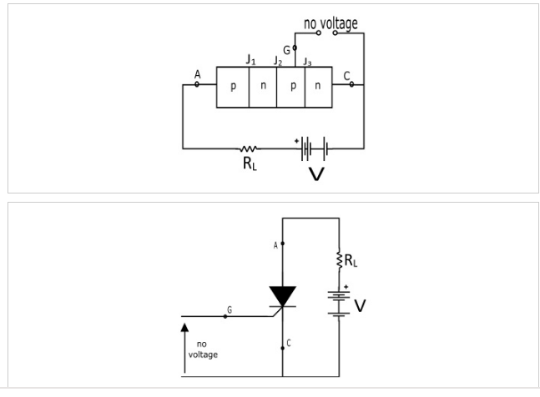

Slide 7
When Gate is Positive with Respect to Cathode
The SCR can be turned ON at smaller applied voltage by the application of a small positive voltage at the gate terminal.
When gate voltage is applied the junction J3 is forward biased and junction J2 is reverse biased. Thus, the electrons from n – type layer starts moving across the junction J3 toward p –type material and the holes from p –type material towards the n – type material. Due to the movement of holes and electrons across the junction J3 the gate current starts flowing.
Because of gate current the anode current increases. The increased anode current makes the more electrons available at the junction J2. As a result of this process, in a small time, the junction J2 breaks down and the SCR is turn ON.

Slide 8
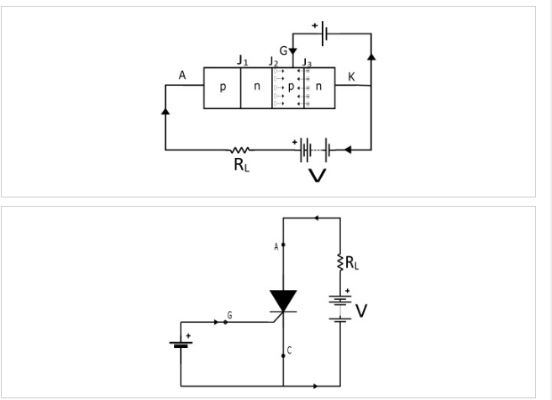

Slide 9
I–V Characteristics of SCR
It is the curve plotted between the anode – cathode voltage (V) and anode current (I) of the SCR at constant gate current.

Slide 10
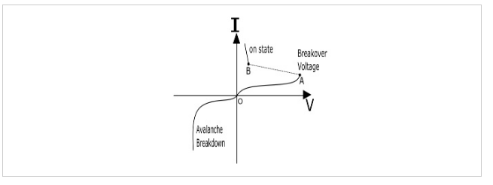

Slide 11
Forward Characteristics − When the anode is made positive with respect to the cathode, then the curve between V and I is called as forward characteristics of the SCR. If the supply voltage is increased from zero, a point is reached (Point A, the voltage is called breakover voltage) when the SCR starts conducting. Under this condition, the voltage across SCR decreases suddenly (shown by dotted line in the curve) and the most of the supply voltage appears across the load.

Slide 12
Reverse Characteristics − When anode is made negative with respect to the cathode, the curve plotted between V and I is called as reverse characteristics. If the reverse voltage is increased gradually, at first the anode current remains small (called leakage current) and at some reverse voltage, the avalanche breakdown occurs and the SCR starts conducting in the reverse direction (Shown by the curve in third quadrant). The maximum reverse voltage at which the SCR starts conducting in the reverse direction is called as Reverse Breakdown Voltage.

Slide 13
Applications of SCR
The SCR can be used in following application −
Power Switching Circuit
Controlled Rectifier
AC power control circuits
Speed control of DC shunt motor
SCR Crowbar
Computer logic circuits
Timing Circuits
Inverters
Battery Charging Regulators
Temperature control systems

Slide 14
Half Wave Rectifier?
one half of each a.c input cycle is rectified.
When the p-n junction diode is forward biased, it gives little resistance and when it is reversed biased it provides high resistance
During one-half cycles, the diode is forward biased when the input voltage is applied and in the opposite half cycle, it is reverse biased.
During alternate half-cycles, the optimum result can be obtained.

Slide 15
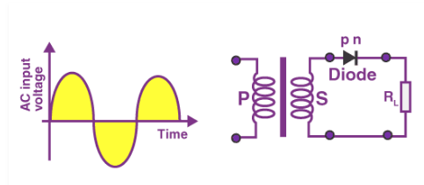
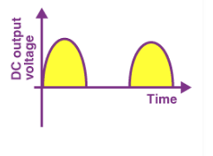

Slide 16
The half-wave rectifier has both positive and negative cycles. During the positive half of the input, the current will flow from positive to negative which will generate only a positive half cycle of the a.c supply.
When a.c supply is applied to the transformer, the voltage will be decreasing at the secondary winding of the diode. All the variations in the a.c supply will reduce, and we will get the pulsating d.c voltage to the load resistor.

Slide 17
n the second half cycle, the current will flow from negative to positive and the diode will be reverse biased.
Thus, at the output side, there will be no current generated, and we cannot get power at the load resistance. A small amount of reverse current will flow during reverse bias due to minority carriers

Slide 18
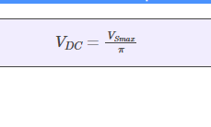
Ripple factor is the ratio of RMS value of the AC component of the output voltage to the DC component of the output voltage.
DC Output Voltage
The output DC voltage appears at the load resistor R_{L} which is obtained by multiplying output DC voltage with the load resistor R_{L.} The output DC voltage is given as:

Slide 19
Form Factor
The form factor is the ratio of RMS value to the DC value. For a half-wave rectifier, the form factor is 1.57.
Rectifier Efficiency
Rectifier efficiency is the ratio of output DC power to the input AC power. For a half-wave rectifier, rectifier efficiency is 40.6%.
Advantages of Half Wave Rectifier
Affordable
Simple connections
Easy to use as the connections are simple
Number of components used are less

Slide 20
Disadvantages of Half Wave Rectifier
Ripple production is more
Harmonics are generated
Utilization of the transformer is very low
The efficiency of rectification is low
Applications of Half Wave Rectifier
Following are the uses of half-wave rectification:
Power rectification: Half wave rectifier is used along with a transformer for power rectification as powering equipment.
Signal demodulation: Half wave rectifiers are used for demodulating the AM signals.
Signal peak detector: Half wave rectifier is used for detecting the peak of the incoming waveform.

Slide 21
What Is Full Wave Rectifier?
Full-wave rectifier circuits are used for producing an output voltage or output current which is purely DC.
The main advantage of a full-wave rectifier over half-wave rectifier is that such as the average output voltage is higher in full-wave rectifier, there is less ripple produced in full-wave rectifier when compared to the half-wave rectifier.

Slide 22
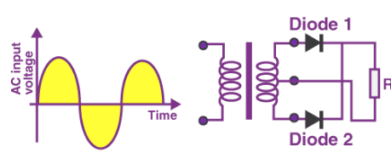
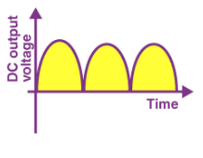

Slide 23
Working of Full Wave Rectifier
The full-wave rectifier utilizes both halves of each a.c input.
When the p-n junction is forward biased, the diode offers low resistance and when it is reverse biased it gives high resistance.
The circuit is designed in such a manner that in the first half cycle if the diode is forward biased then in the second half cycle it is reverse biased and so on.

Slide 24

Ripple Factor
Ripple factor for a full-wave rectifier is given as:

Slide 25
Form Factor
The form factor is the ratio of RMS value of current to the output DC voltage. The form factor of a full-wave rectifier is given as 1.11
Rectifier Efficiency
Rectifier efficiency is used as a parameter to determine the efficiency of the rectifier to convert AC into DC. It is the ratio of DC output power to the AC input power. The rectifier efficiency of a full-wave rectifier is 81.2%.

Slide 26
Types of Full Wave Rectifier
There are two main types of full-wave rectifiers, and they are:
Two diodes full-wave rectifier circuit (requires a center-tapped transformer and is used in vacuum tubes)
Bridge rectifier circuit (doesn’t require a centre-tapped transformer and is used along with transformers for efficient usage)
Advantages of Full Wave Rectifier
The rectifier efficiency of a full-wave rectifier is high
The power loss is very low
Number of ripples generated are less

Slide 27
Applications of Full Wave Rectifier
Following are the uses of full-wave rectifier:
Full-wave rectifiers are used for supplying polarized voltage in welding and for this bridge rectifiers are used.
Full-wave rectifiers are used for detecting the amplitude of modulated radio signals.

